Slide 1




Data Visualization:
(0602344)
Submitted To: Dr. Rasha Al-bashaireh

Slide 2
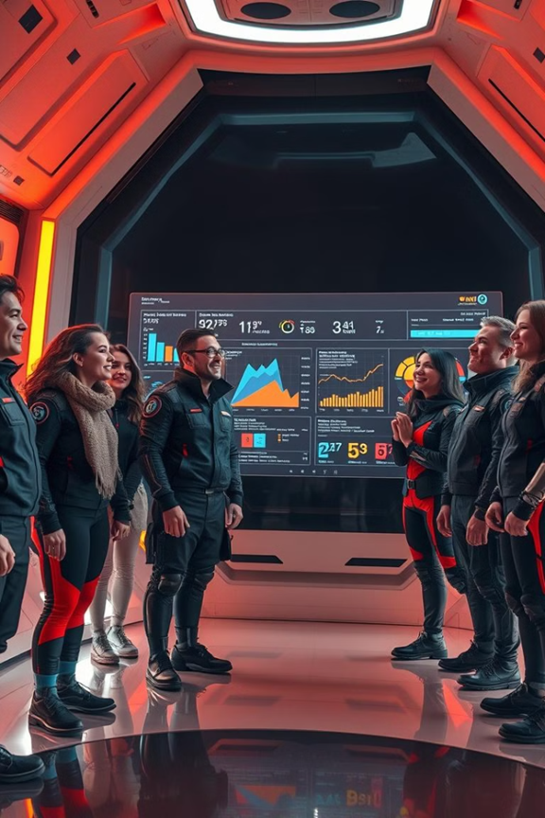

Boycott companies
Group number: 10
Group member name:
-Mohammad nooraldeen
-Obadah alghonami
-Mohammad Alotaibi
-Hassan alomari

Slide 3

Boycott companies
About the dataset
Data exploring
Our dataset covers companies that support the occupation and the impact of the boycott on them.
Contain 3 column 48 row,
contain Date and Cap,
Rate of change
df.shape :
(48,3)

Slide 4

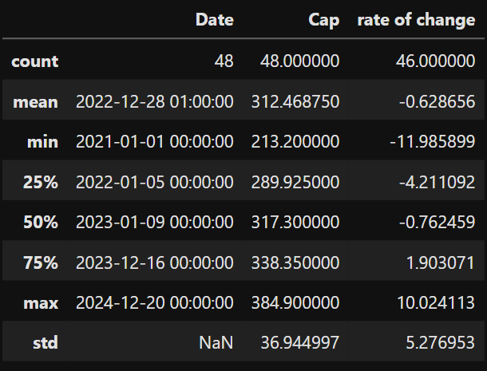
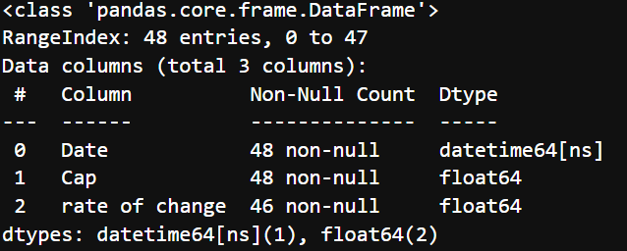

Data exploring
df.describe():
df.info():

Slide 5
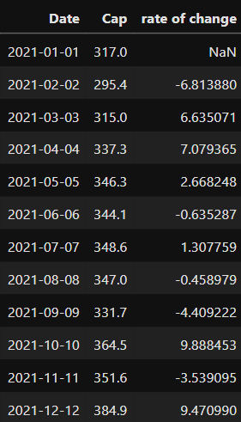

Dataset snapshot

Slide 6
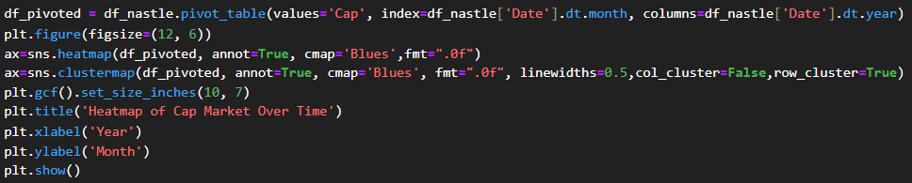
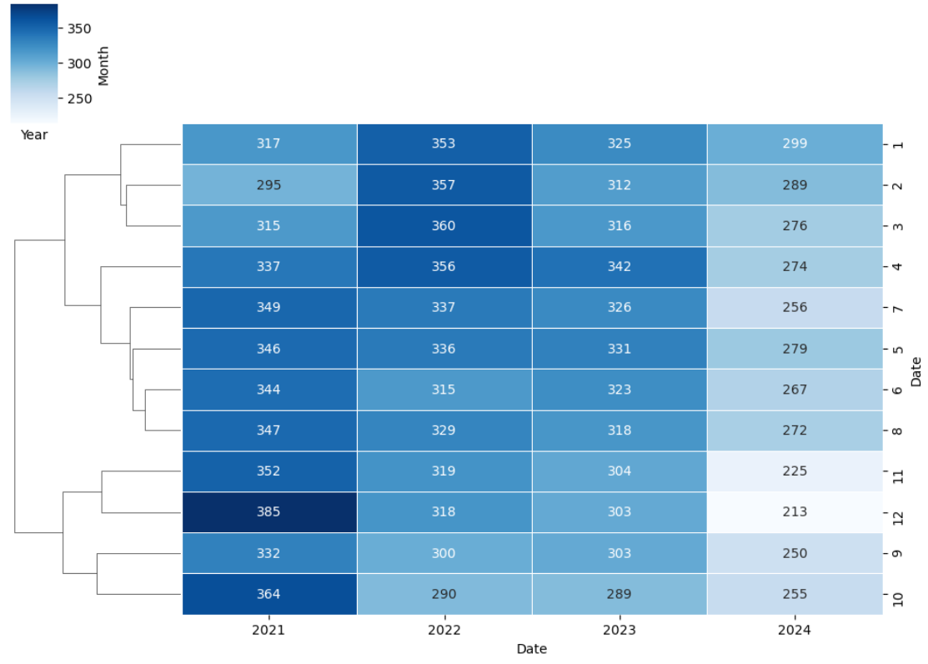
Data visualizations (Nastle)

Slide 7
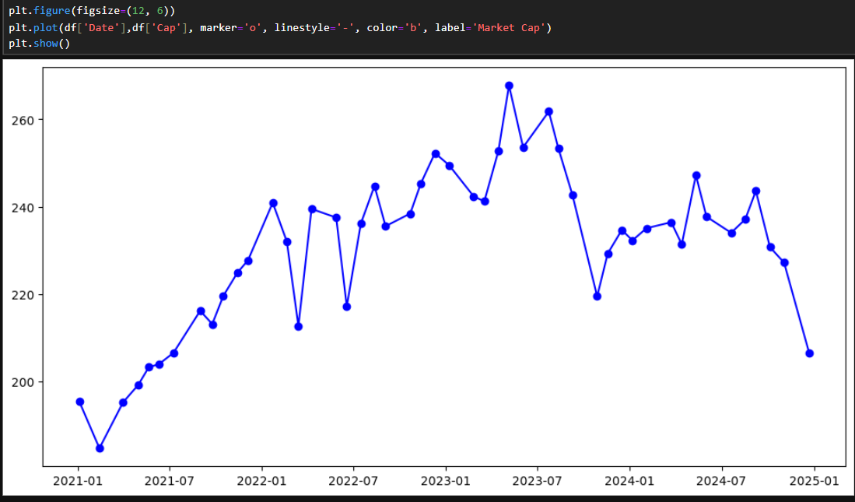
Data visualizations (Pepsi)

Slide 8
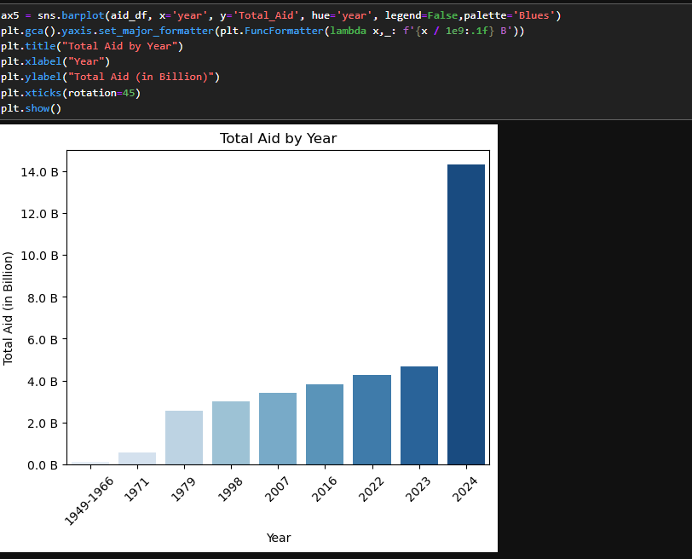
Data visualizations

Slide 9
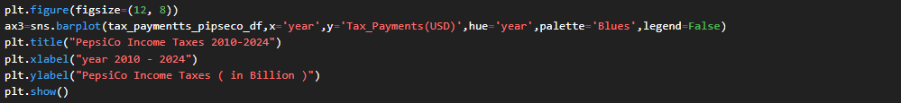
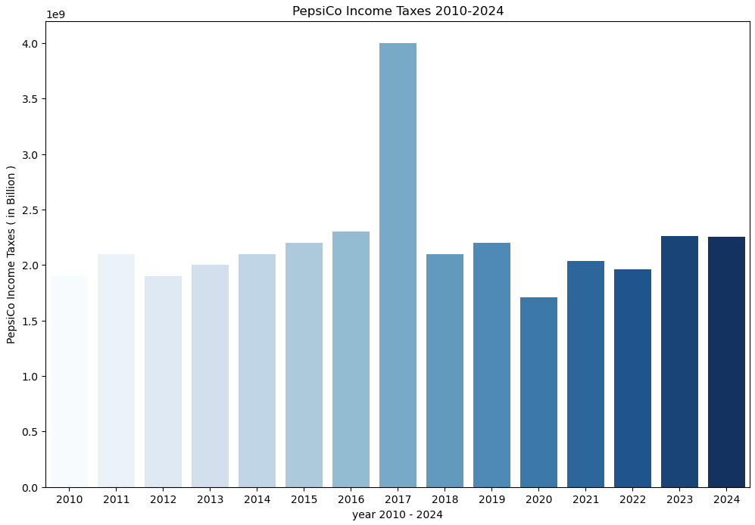
Data visualizations

Slide 10
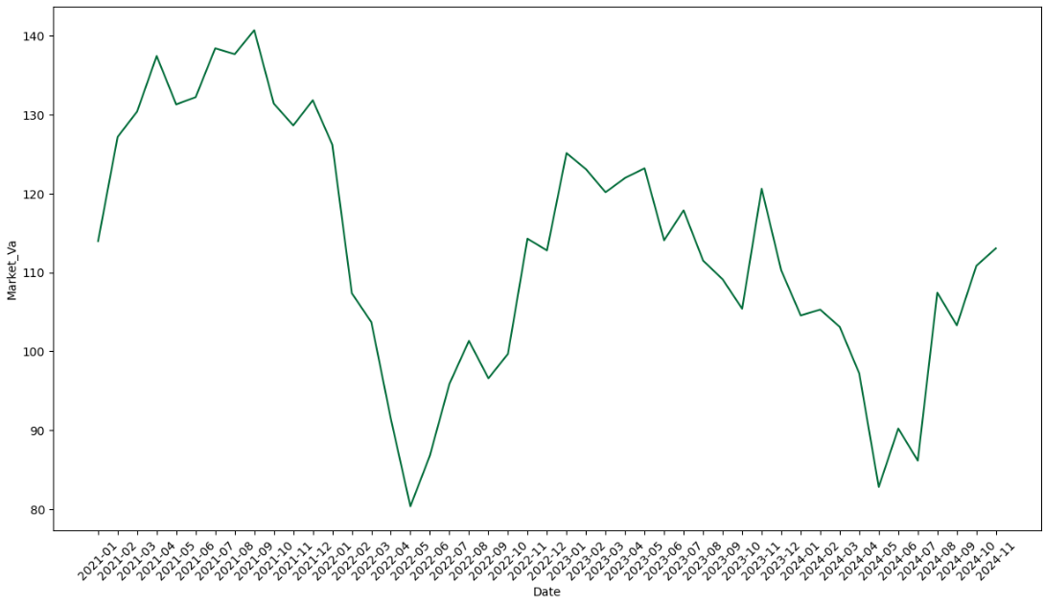
Data visualizations (Starbucks)

Slide 11
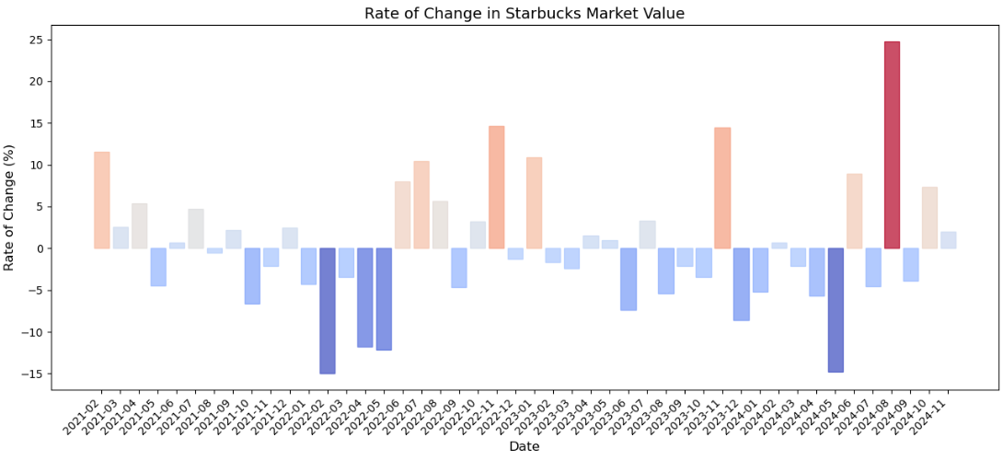
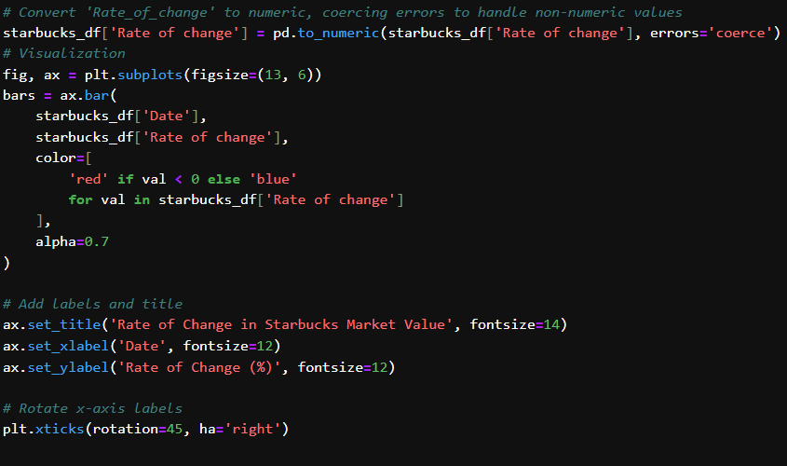
Data visualizations

Slide 12
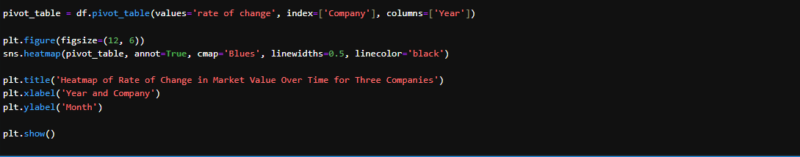
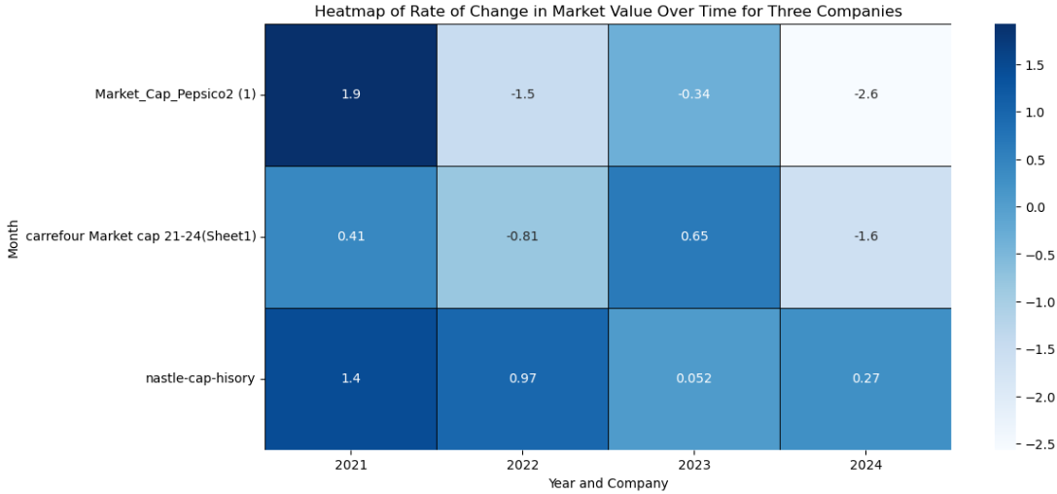
Data visualizations

Slide 13
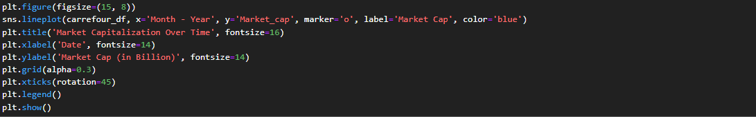
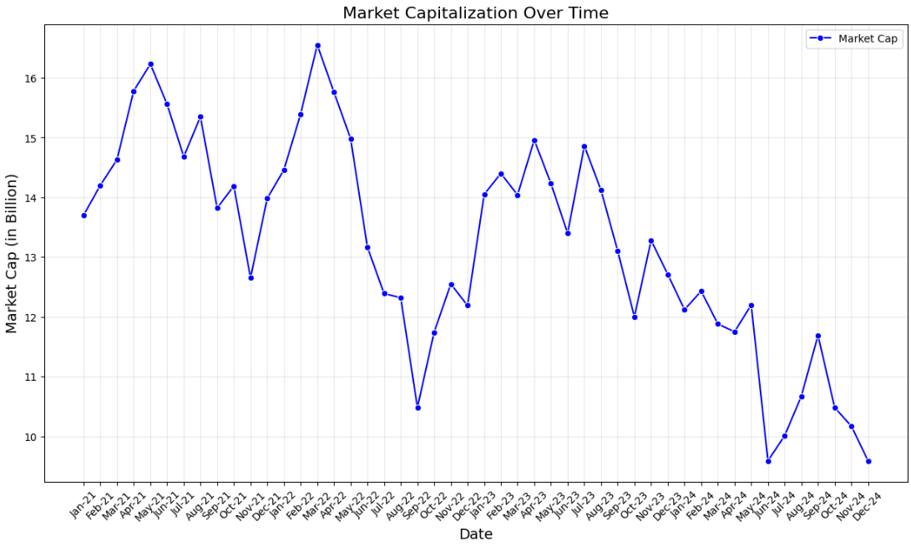
Data visualizations (Carrefour)

Slide 14

reference
https://companiesmarketcap.com/carrefour/marketcap/
https://companiesmarketcap.com/pepsico/marketcap/
https://companiesmarketcap.com/starbucks/marketcap/
https://companiesmarketcap.com/nestle/marketcap/

